Slide 1


The Digital Guardian: Understanding Spam Detection
Spam detection is the automated process used to identify and filter unsolicited, malicious, or irrelevant messages (spam) from legitimate ones (ham). It employs a combination of rules and learning algorithms to analyze incoming data. The primary objective is to maintain a secure and uncluttered digital communication environment for users.

Slide 2









Navigating the World of Spam Detection
Explore the critical aspects of how we keep our digital spaces safe and clean.
Importance of Spam Detection
Types of Spam
Working Principle
Why this technology is crucial for digital safety.
Understanding the various forms of unwanted messages.
How spam filters analyze and score messages.
Detection Techniques
Algorithms Used
System Steps
The methods used to identify suspicious content.
The machine learning models powering modern filters.
The journey of a message through the detection process.
Applications
Advantages & Disadvantages
Conclusion
Where spam detection is used beyond email.
Weighing the benefits against the challenges.
Summarizing the impact and future of spam detection.

Slide 3



The Indispensable Role of Spam Detection
Spam detection is vital for cybersecurity, serving as the first line of defense against phishing, malware, and ransomware attacks. It enhances user productivity by keeping inboxes clean and saves valuable network bandwidth and server storage.
This protection is critical for both individual users and large organizations, safeguarding sensitive data and ensuring uninterrupted digital operations. Without robust spam filters, our digital lives would be overwhelmed by threats and clutter.
Cybersecurity Defense
First line of defense against digital threats.
Enhanced Productivity
Clean inboxes mean more focused work.

Slide 4





Understanding the Many Faces of Spam
Spam manifests in several forms, each with a different objective, designed to deceive or annoy.
Phishing Emails
Malware Spam
Scam Emails
Aim to steal sensitive credentials like passwords and financial information by impersonating trusted entities.
Distributes harmful software (viruses, ransomware, spyware) that can compromise systems and data.
Attempt to defraud victims financially through various schemes, often promising large sums of money or urgent requests.
Unsolicited Advertising
Adult Content
Promotional content for products or services that the recipient did not request, often overwhelming inboxes.
Unwanted messages containing explicit or inappropriate material, often linked to scams or malware.

Slide 5



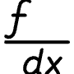

The Core Principle: How Spam Filters Work
The core principle involves analyzing various features of an incoming message to calculate a "spam score." If this score surpasses a predefined threshold, the system flags the message as spam and quarantines it. This process is adaptive, constantly learning from new data and user feedback to improve its accuracy.
Incoming Message
New email arrives
Feature Analysis
Extract message features
Spam Score Calculation
Compute threat score
Flag as Spam
Quarantine and review

Slide 6




Advanced Detection Techniques
Several sophisticated techniques are used in conjunction to identify and neutralize spam effectively.
Content-Based Filtering
Analyzes the text and body of the message for suspicious keywords, phrases, and patterns commonly found in spam.
Header Analysis
Verifies the authenticity of the sender and routing information by examining email headers for anomalies or forged data.
Blacklisting
Blocks messages from known spam sources, including specific IP addresses, email domains, or sender addresses identified as malicious.
Heuristic Filtering
Uses rule-based scoring to identify spam-like traits, assigning points for characteristics such as unusual formatting or suspicious links.

Slide 7
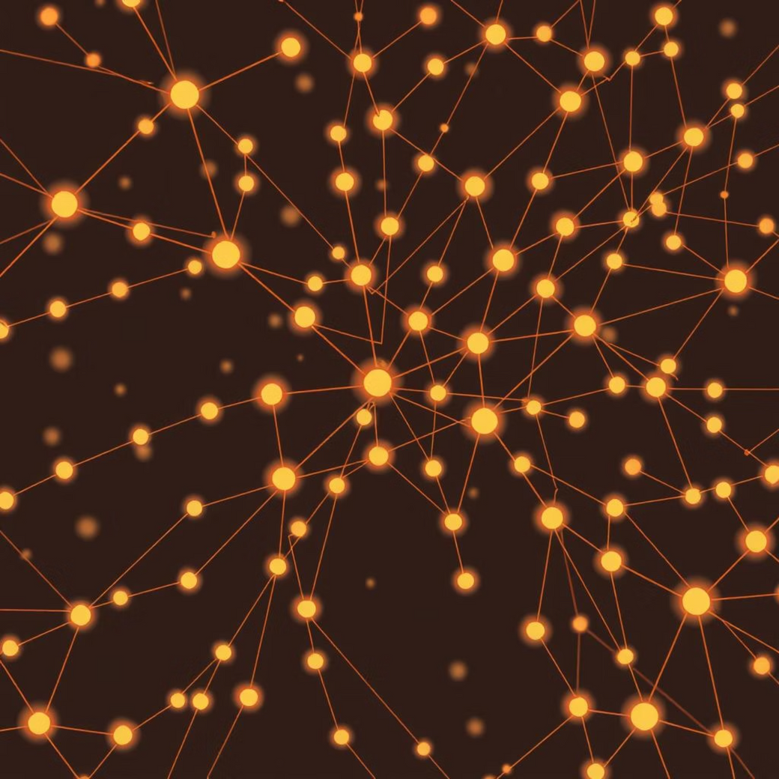
The Brains Behind the Filter: Algorithms Used
Modern spam filters are powered by advanced machine learning algorithms, enabling high accuracy and adaptability against evolving threats.
Naïve Bayes Classifiers
1
Utilize probability to determine if a message is spam based on the frequency and combination of words it contains. Simple yet effective for text classification.
Support Vector Machines (SVM)
2
More advanced algorithms that recognize complex, non-linear patterns in data to identify sophisticated spam, creating clear boundaries between spam and legitimate messages.
Artificial Neural Networks (ANN)
3
Mimic the human brain's structure to learn and adapt, excelling at identifying highly complex and evolving spam patterns, including image-based spam.
These algorithms continuously learn and improve, making spam detection a dynamic and increasingly intelligent defense mechanism.

Slide 8
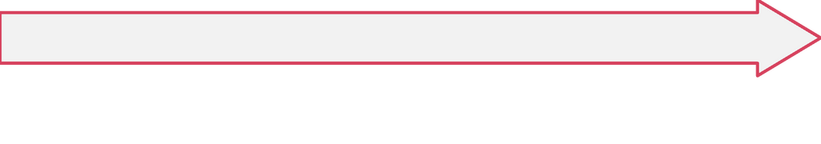
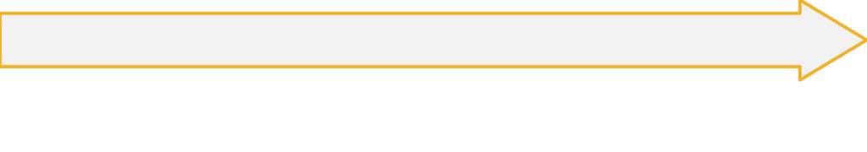
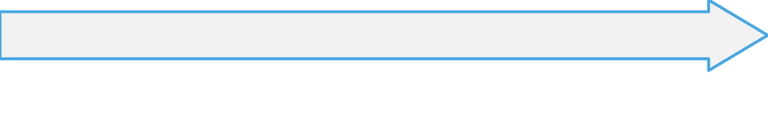

The Spam Detection Workflow
The detection process follows a clear, systematic workflow to ensure efficient and accurate message classification.
Feature Extraction
Data Pre-processing
Key analytical points or "features" are extracted from the cleaned message. These can include word frequencies, header information, and URL patterns, which are then converted into a numerical format for the model.
The initial stage where the incoming message is cleaned, removing irrelevant elements like HTML tags, special characters, and stop words, to prepare it for analysis.
Final Action
Message Classification
Based on the classification, the system takes a final action: either delivering the legitimate message to the user's inbox or filtering the identified spam into a junk folder or quarantine.
The pre-processed and feature-extracted message is fed into the trained machine learning model, which then classifies it as either "spam" or "ham" (legitimate) based on its learned patterns.

Slide 9






Beyond Email: Widespread Applications of Spam Detection
While commonly associated with email, spam detection is crucial in many other digital environments, ensuring clean and safe interactions across various platforms.
Diverse Applications
Email Clients
Securing inboxes like Gmail and Outlook from unwanted messages.
Blog Comments
Filtering out irrelevant or malicious comments on websites and blogs.
E-commerce Reviews
Preventing fake or spammy reviews that can mislead consumers.
SMS Messages
Blocking unwanted text messages, including scams and unsolicited promotions.
Social Media
Stopping the spread of malicious content, fake accounts, and spam posts.

Slide 10


Challenges and the Future of Spam Detection
Disadvantages & Challenges
Conclusion & Future Outlook
False Positives
Spam detection is an indispensable and dynamic technology in our digital world. By integrating advanced machine learning, it provides a critical defense against a wide array of online threats, ensuring that communication channels remain safe and reliable.
Legitimate emails are mistakenly flagged as spam, causing important information to be missed or delayed.
The ongoing evolution of Artificial Intelligence and machine learning will continue to shape the future of this essential cybersecurity field, leading to even more sophisticated and proactive defense mechanisms against unwanted digital intrusions.
Constant Updates Required
Spam filters need continuous maintenance and updates to keep pace with spammers' evolving and creative tactics.
Resource Intensive
Advanced algorithms and real-time processing can demand significant computational resources.

